Slide 1
Hack.Out
By Diego Prado, Gerard Nelson, Richard Lebell, Jacob Ryans

Slide 2
overview
In the game, you control a 2d character going through a cyberspace of different classic game dimensions. By solving computer science related problems, you access new areas.
You control the character by using the arrow keys, which is processed through pygame, an essential library used when we made the game. The inspiration for the soundtrack and game stems from classing sub-1990 NES games.
The code is mainly object oriented and uses dictionaries, which shows the skills we focused on throughout the 130 series.

Slide 3
Link and materials
https://github.com/renegade27/Final-Pi-Project
Since we couldn’t incorporate GPIO usability, there weren’t really any physical materials.

Slide 4
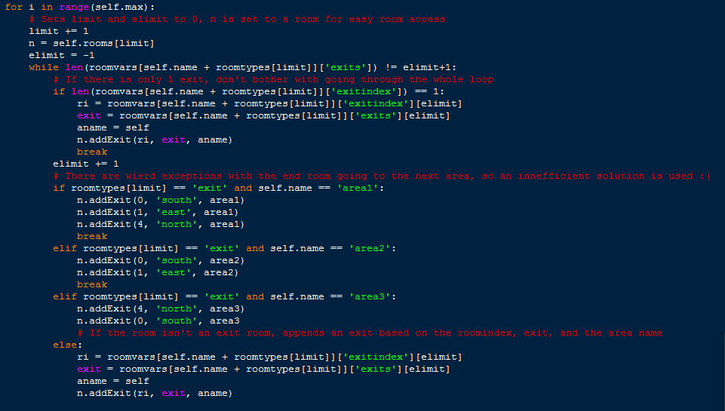
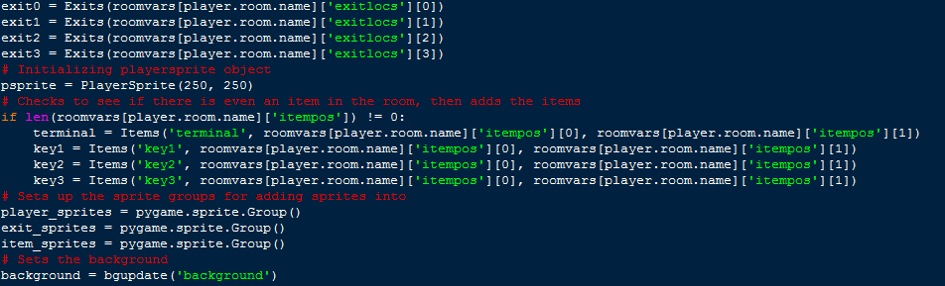
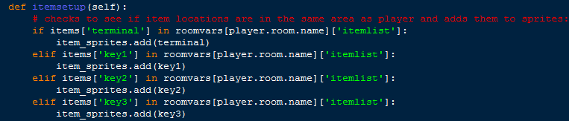
source code – P1
Area Handling Sprite Handling

Slide 5
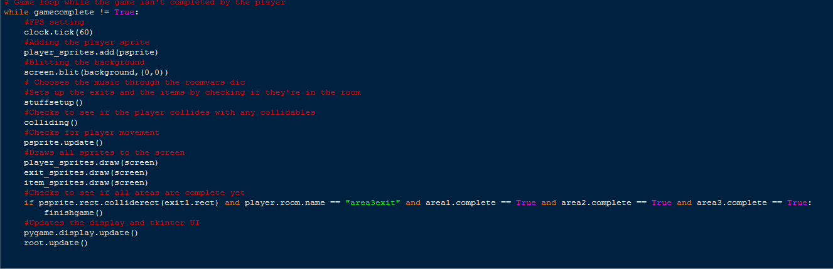
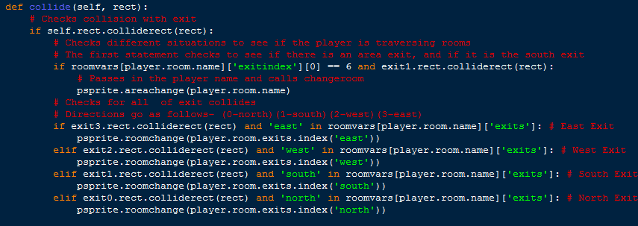
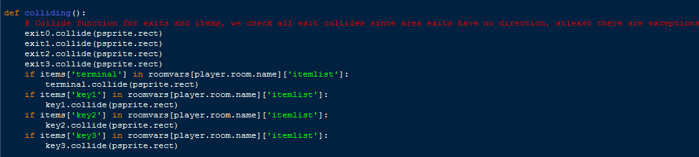
Source Code – p2
Game Loop Collision Detection

Slide 6
The Art Creation
The creation of the art was done by Gerard Nelson. He chose specific backgrounds to invoke nostalgia within the player. Sprite work is tricky, so we chose the most knowledgable person on art in our group to do this.
The creation of the soundtrack was done by Jacob Ryans. The soundtracks for each area come from the area theme, and were chosen carefully to give each area a complete robust identity.

Slide 7
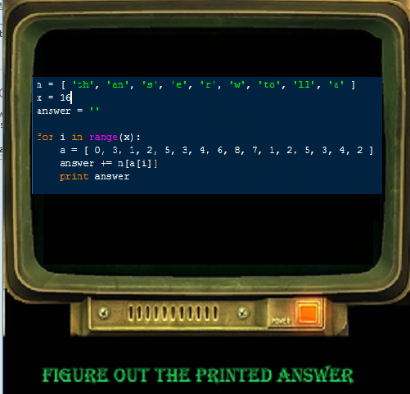
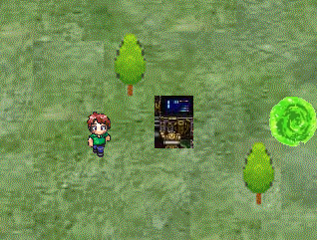
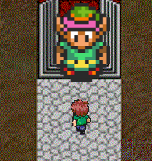
demonstration
The main goal of the game is to find the terminal, which gives you the puzzle to solve for the area. Then, you must find the “Key” character of the area, and submit your answer, thus giving you access to the next Area portal.

Slide 8
Old and new targets
Old targets – Implement character movement and room tracking. Debug exit errors and room setup errors. Add functioning images and create unique backgrounds for each area.
New targets – Implement more areas, add animated character walking through a circular picture buffer. Add tkinter usability with an inventory and area completion UI. Create more unique backgrounds, random soundtrack selection, and add a full story to the game. Add cutscenes for the start and end of the game sequences.

Slide 9
future development and lessons
Future development to our project could add diverse player movement and object clipping. Making our game more unique will be another step we strive to complete. Another feature we will add is you can fight enemies in the rooms. Also we could improve our program by giving the player a map of the area and cutting dead content.
We learned how to work as a team. We also learned how to code games, debug exceptions, use pygame, and design a game from the ground up.

